Slide 1
AUTOMOBILE SALES TREND ANALYSIS
NAME : Gaayathri Priyaa K R
MENTOR : Jaya Pandey

Slide 2
INTRODUCTION:
As a global supplier of miniature automobiles, we strive to provide our customers with exceptional products and services. To achieve this goal, we must have a deep understanding of our sales data.
This project aims to leverage our sales data to gain valuable insights into our business. By analyzing historical sales trends, customer behavior, and product performance, we will be able to:
Optimize our inventory management
Improve order fulfillment processes
Refine our pricing strategy
Tailor our marketing campaigns to specific customer segments
Ultimately, these insights will help us drive business growth and enhance customer satisfaction.

Slide 3
OBJECTIVE:
Data Exploration and Visualization: Conduct an in-depth analysis of miniature automobile sales data using Tableau to uncover key insights into sales trends, customer behavior, and product performance.
Sales and Customer Analysis: Analyze sales performance, customer segmentation, sales forecasting, and product performance to identify opportunities for improvement and optimization.
Inventory and Order Fulfillment Analysis: Evaluate inventory management strategies and order fulfillment processes to ensure efficient operations and customer satisfaction.
Pricing Strategy Analysis: Analyze pricing strategies to optimize revenue and profitability while maintaining competitiveness in the market.

Slide 4
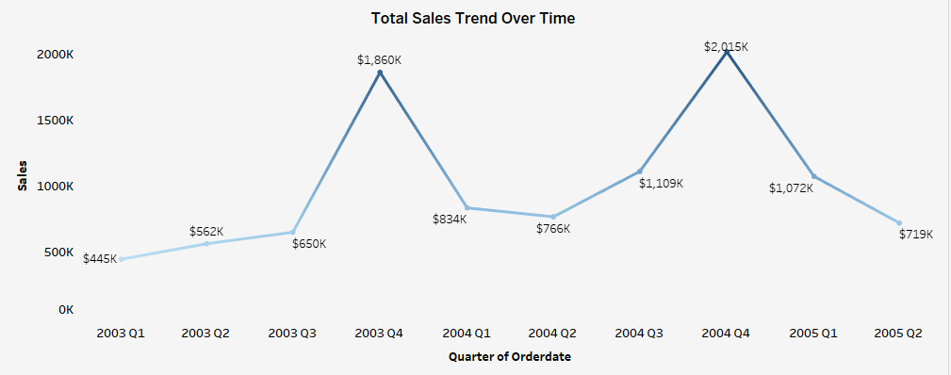
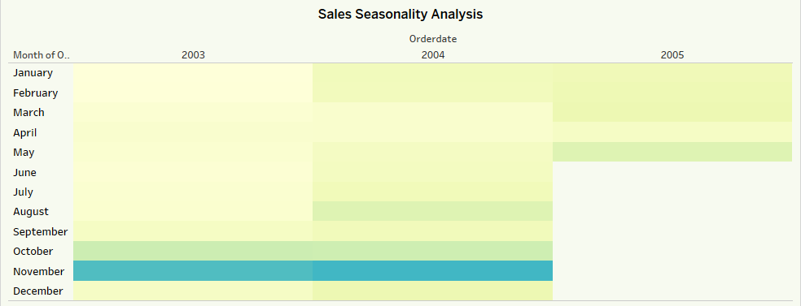
The trend in total sales amount over different quarters and years
Seasonal patterns in sales based on order dates

Slide 5
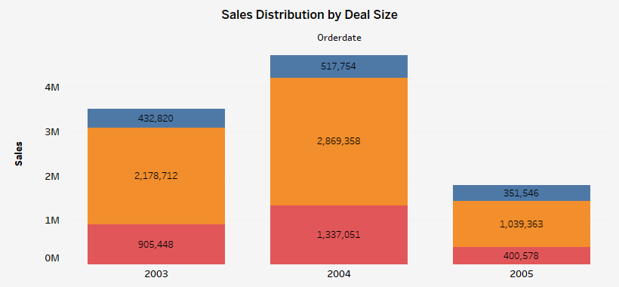
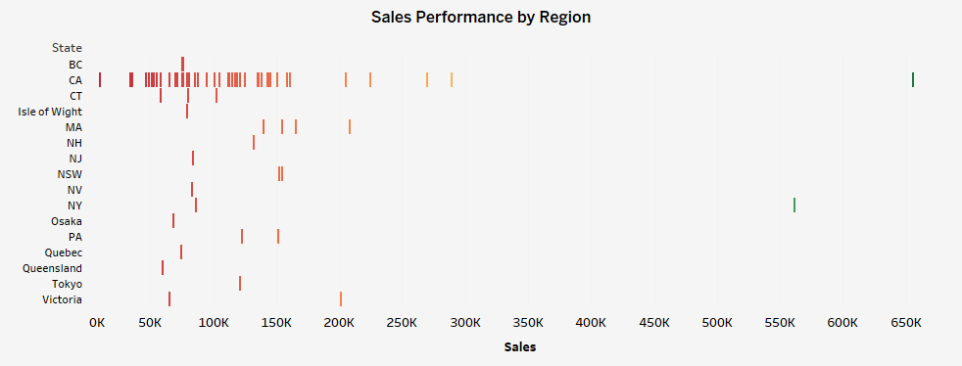
The impact of different deal sizes on total sales
The regional variations in sales based on city and state data

Slide 6
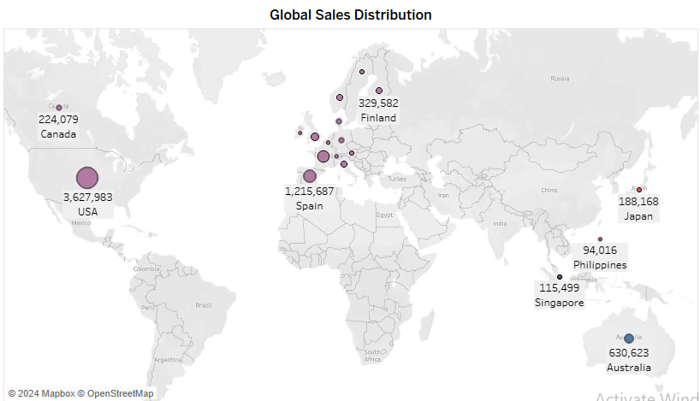
Sales distribution across different countries and territories

Slide 7
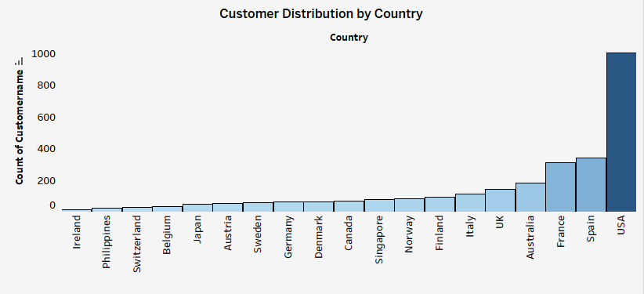
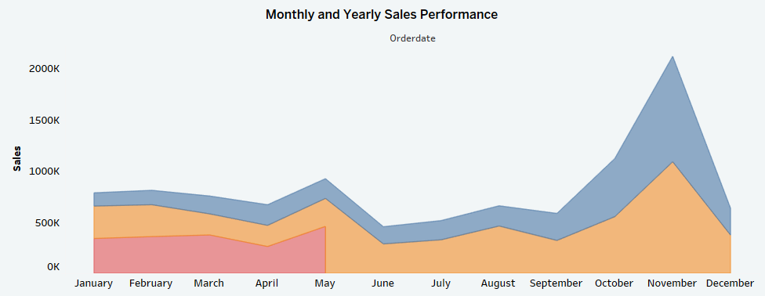
Sales evolution over different months and years
Customer distribution in each country

Slide 8
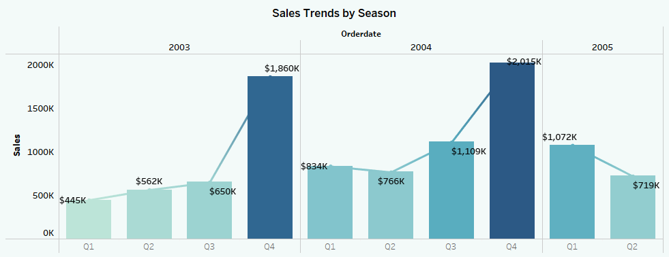
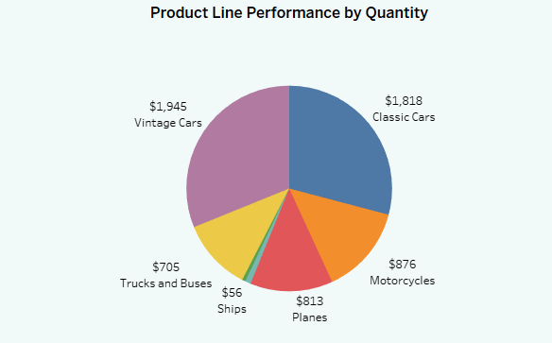
The patterns or seasonality in sales data
Product lines with highest and lowest quantities ordered

Slide 9
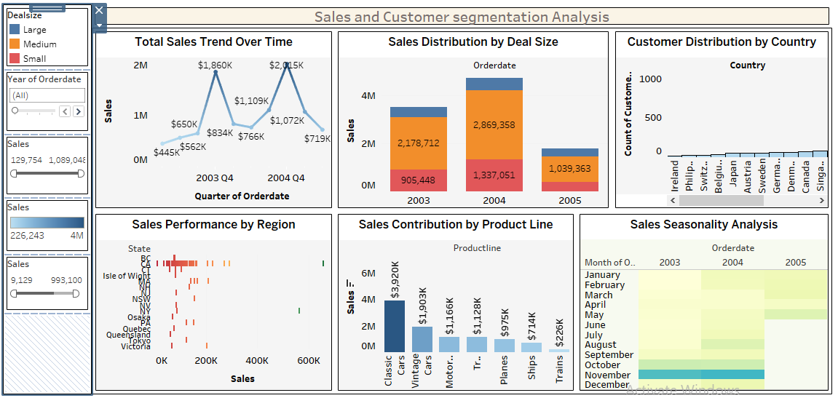
Sales and Customer segmentation Analysis Dashboard

Slide 10
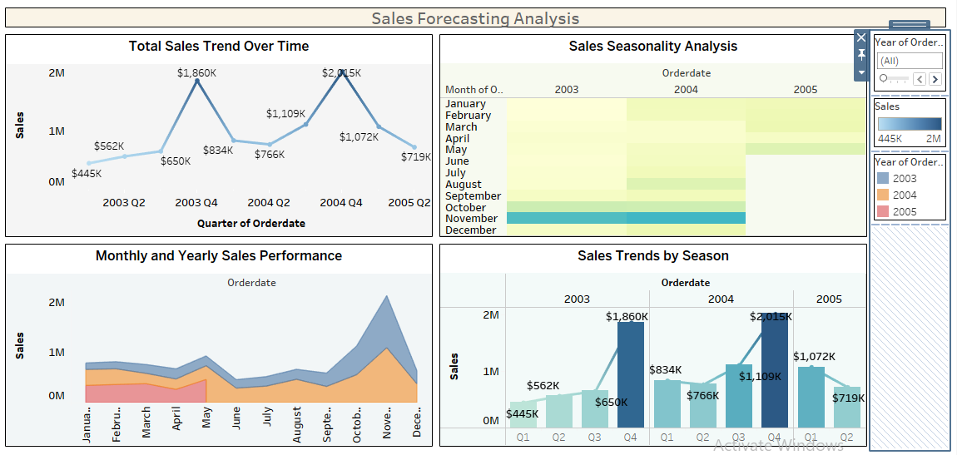
Sales Forecasting Analysis Dashboard

Slide 11
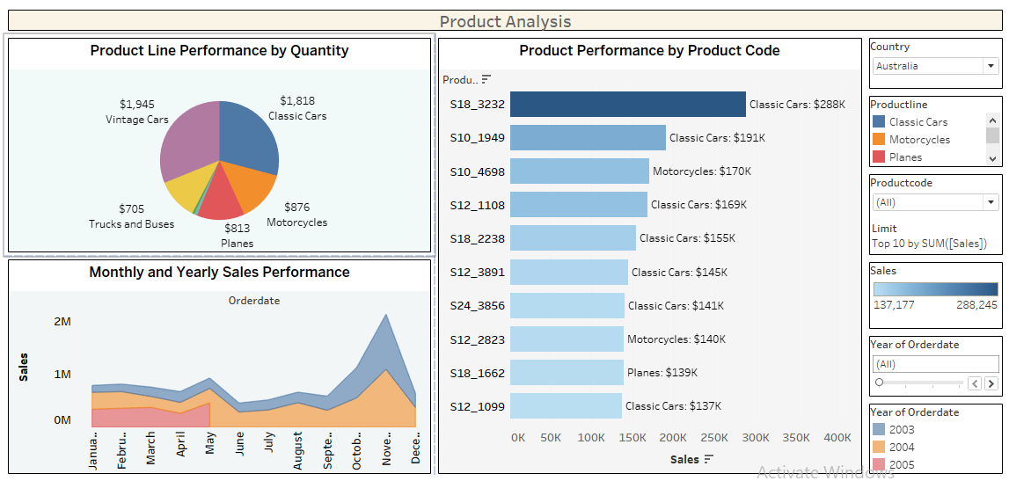
Product Analysis Dashboard

Slide 12
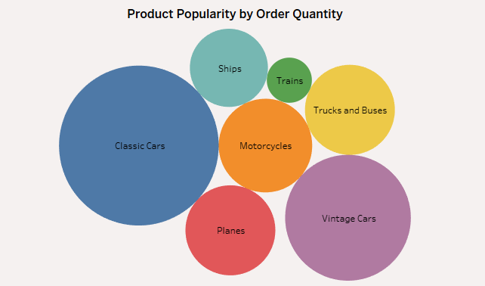
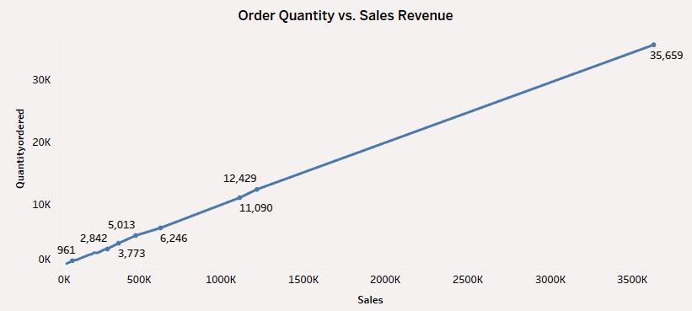
The highest and lowest quantities ordered products
The relationship between ordered quantities and sales for inventory management

Slide 13
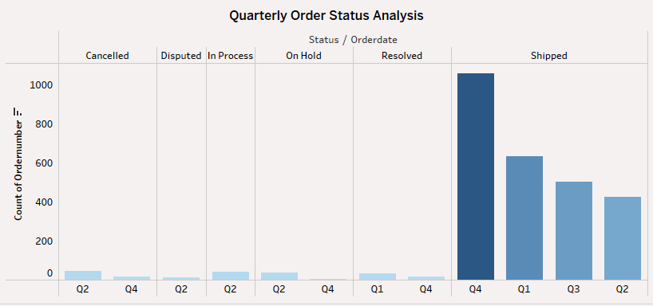
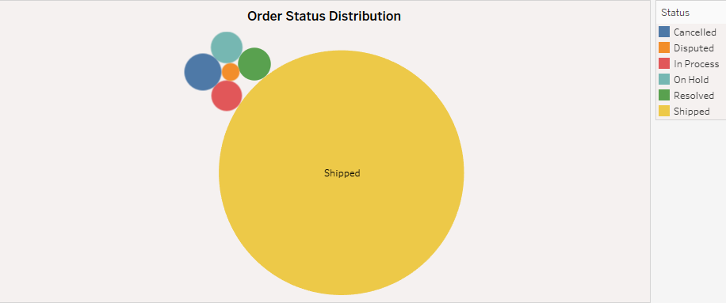
The distribution of order statuses
Patterns in order statuses over different quarters

Slide 14
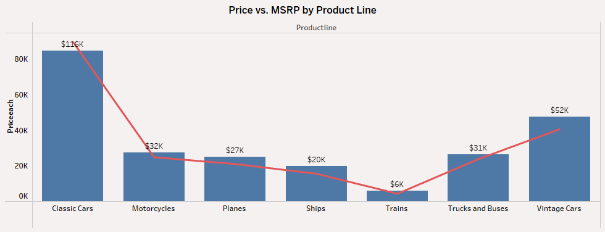
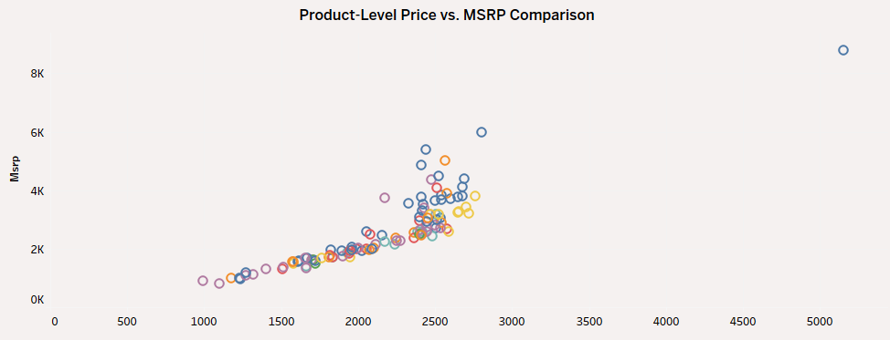
Comparison of the actual price (PRICEEACH) to the MSRP across different products
Comparison of the actual price (PRICEEACH) to the MSRP across different product lines

Slide 15
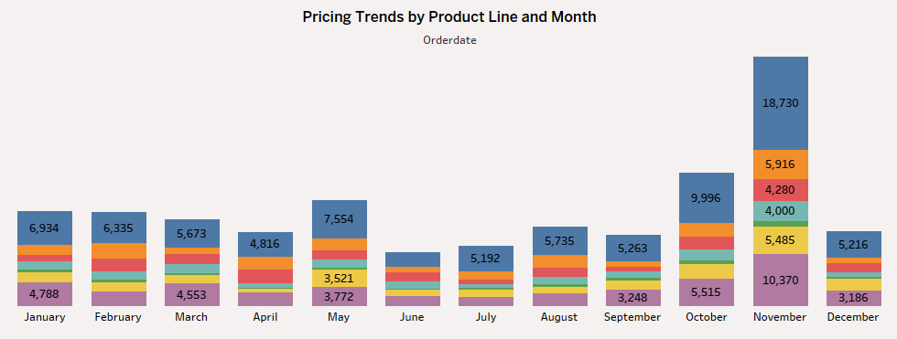
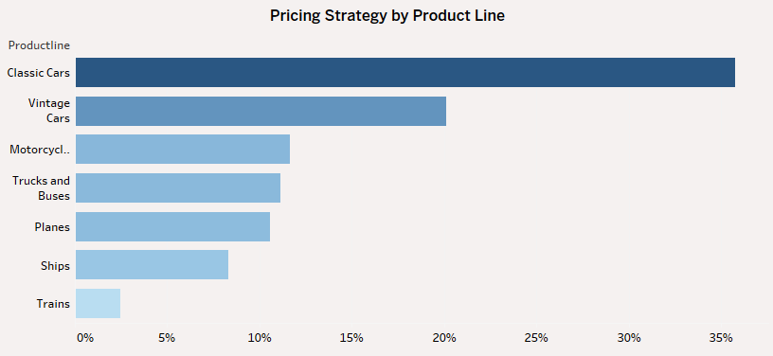
Patterns in pricing strategy based on product lines over the months
The pricing strategy vary across different product lines

Slide 16
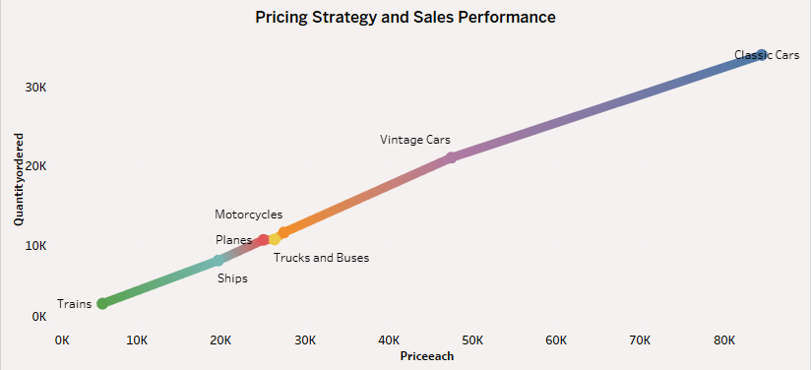
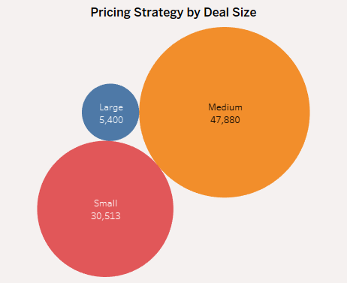
Relation between pricing strategy and sale across all products
How does pricing strategy vary across different deal sizes?

Slide 17
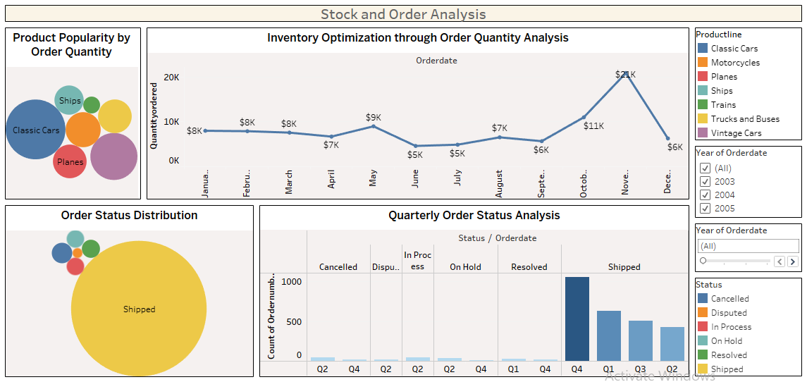
Stock and Order Analysis Dashboard

Slide 18
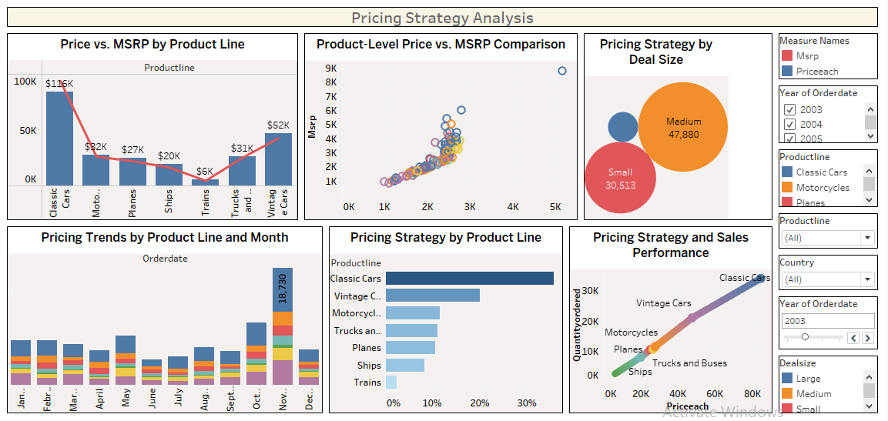
Pricing Strategy Analysis Dashboard

Slide 19
Project 1 summary:
Sales Performance: The company experienced significant growth in 2003-2004, particularly driven by "Classic Cars" and "Vintage Cars." However, a downturn occurred in late 2004 and into 2005.
Product Popularity: "Vintage Cars" and "Classic Cars" are the top-selling product lines, while "Trains" and "Ships" have the lowest demand.
Regional Performance: The USA and Spain are the largest markets, while EMEA has a higher concentration of medium-sized deals compared to APAC and Japan.
Seasonal Trends: Sales exhibit a strong seasonal pattern, peaking in November and December, and declining during summer months.

Slide 20
Project 2 summary:
Product Demand: Classic Cars are the most popular product, while Trains are the least popular. There's a seasonal demand pattern, with peak demand in October.
Order Fulfillment: The order fulfillment process is efficient, with most orders shipped on time. However, there was a noticeable increase in order cancellations in Q4.
Pricing Strategy: The company generally sells products below MSRP, with Classic Cars and Trucks/Buses being closer to MSRP. There's a positive correlation between price and quantity ordered for some products, particularly Classic Cars and Vintage Cars.
Deal Size Pricing: The company employs a tiered pricing strategy, with higher prices for larger deals.

Slide 21
Thank You

